Slide 1


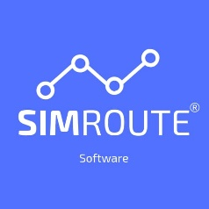
Ship Weather Routing software for academic purposes
Chalmers University of Technology
April 5th & 6th, 2022

Slide 2
SIMROUTE Pretest
https://forms.gle/YjxJ3za9Zs5cvcPU8

Slide 3
SIMROUTE Pretest
Do you know what is weather ship routing optimization?

Slide 4
Weather Ship Routing
“Optimal plan route / ship routing / route optimisation” a factor of competiveness in maritime industry”.
Notes:
Term used for navigating at sea while taking both currents and fore- casted weather into consideration to get the most favorable route.

Slide 5
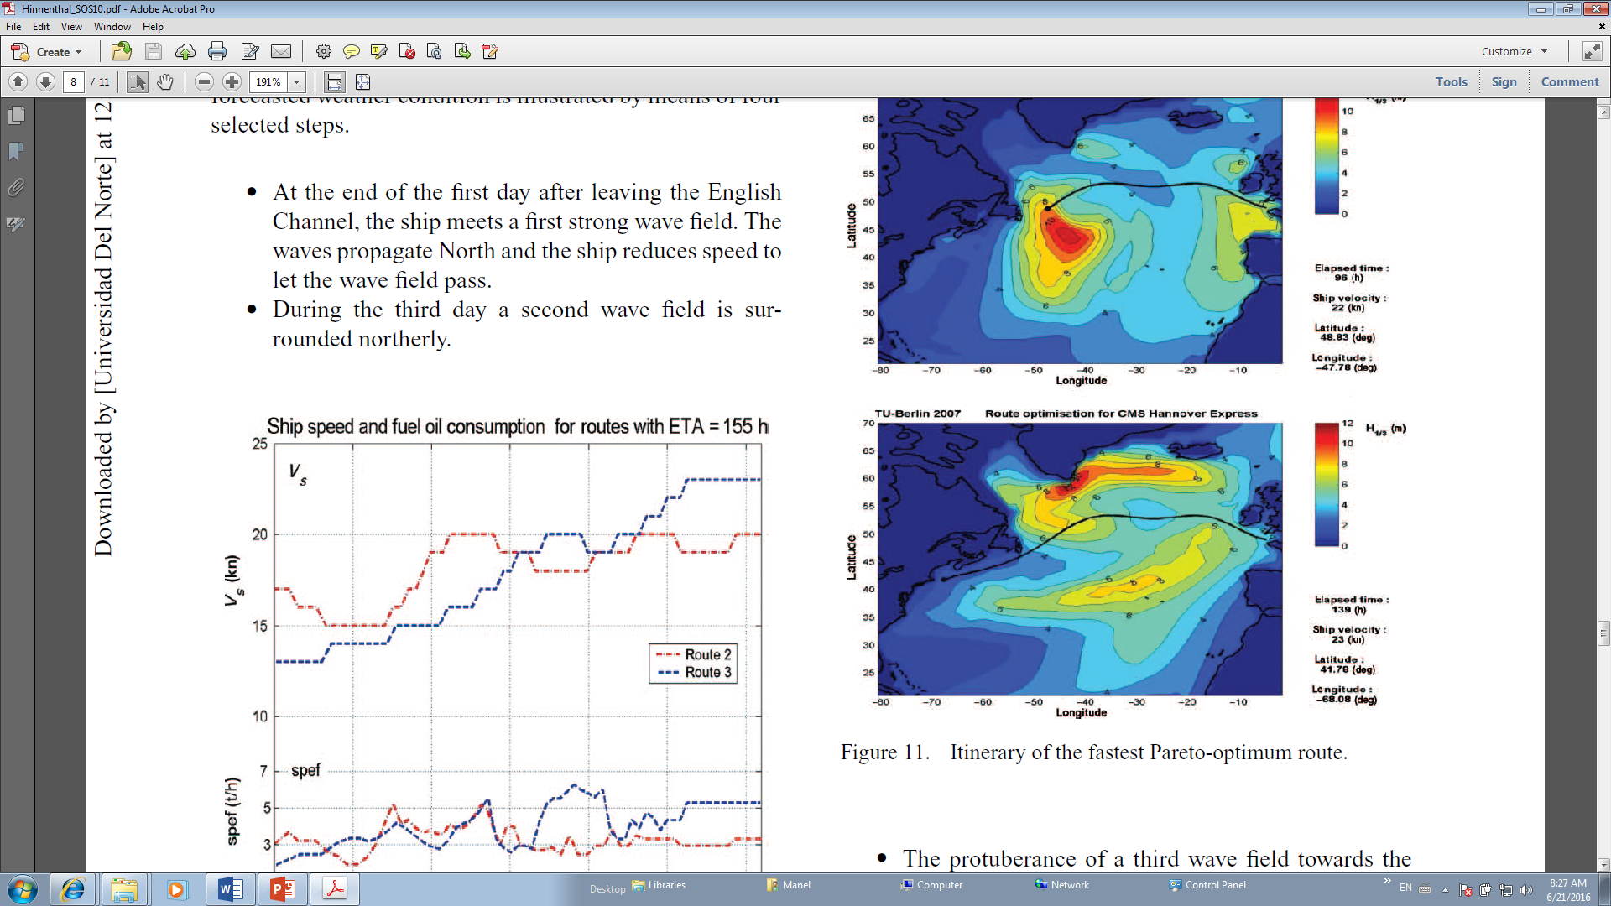
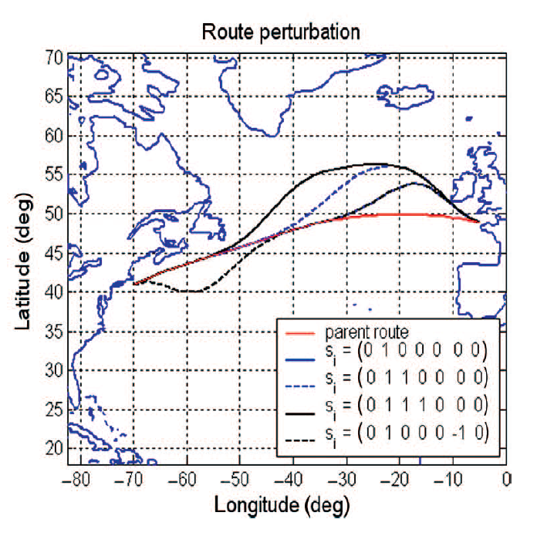
Weather Ship Routing
Meteo-oceanographic conditions are considered in trans-oceanic ship routing.

Slide 6
Weather ship routing
Effect of applying weather ship routing
In terms of sailing time
Minimization of fuel consumption
Air emissions mitigation
Increase of the safety navigation

Slide 7
SIMROUTE software
Developed by a team of researchers at the Universitat Politècnica de Catalunya (UPC-BarcelonaTech).
Design a software that provides skills for ship routing design and optimization.

Slide 8
SIMROUTE software
Taking into account the need to incorporate new technology in MET, new academic modules based on WSR software are designed, namely:
Weather routing module. Software’s Familiarization
Marine environmental module
AIS module
Safety navigation module

Slide 9
Weather routing module

Slide 10
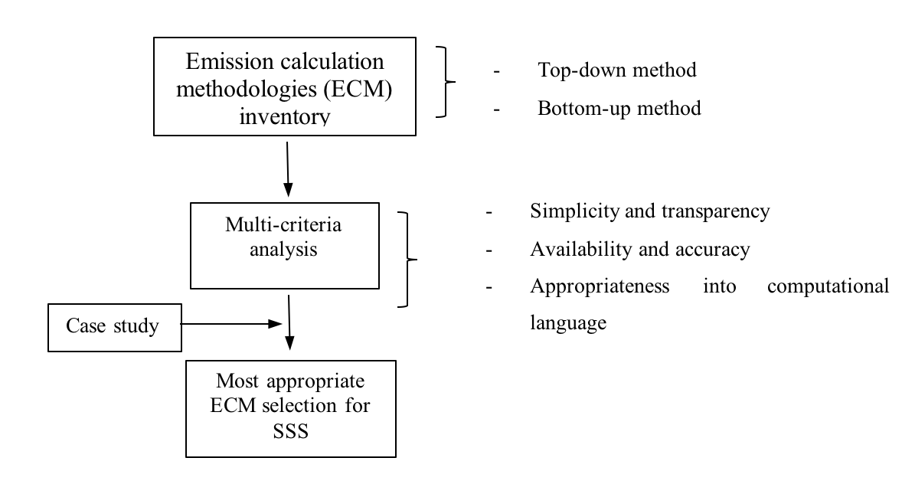
2. Marine environmental module

Slide 11
3. AIS module

Slide 12
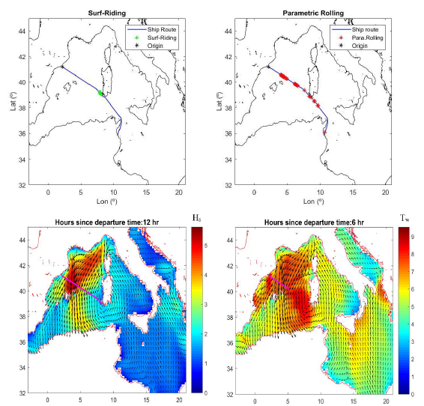
4. Safety navigation module
Bcn-Sousse/Rough-High sea/High Speed Craft.
From left to right: parametric rolling plot and surf-riding plot

Slide 13
Workshops
Workshop Day 1: software familiarization, forecast weather and oceanographic conditions, software feasibility.
Workshop Day 2: SIMROUTE® Marine environmental module: methodology and calculation of Ship Emissions. Further modules.

Slide 14
Workshops
Each module is divided into three main parts:
Briefing
Exercise
Debriefing

